Slide 1

Diabetes Health Indicators
Capstone Project
Group 4 Members
Shuru Ebale
Lynette Mwiti
Eunice Ngunjiri
Alex Korir
Daniel Wahome
Violet Musyoka

Slide 2
OVERVIEW
Business Problem
Data Understanding
Modelling
Evaluation
Conclusion
Deployment

Slide 3
INTRODUCTION
According to the International Diabetes Federation, the Diabetes Atlas (2021) reports that 10.5% (537) million of the adult population aged (20-79 years) has diabetes, with almost half unaware that they are living with the condition.
By 2045, IDF projections show that 1 in 8 adults, approximately 783 million, will be living with diabetes, an increase of 46%. Diabetes prevalence was similar in men and women and was highest in those aged 75-79 years
By understanding these trends and challenges, targeted strategies can be developed to improve diabetes prevention and management both globally and in Kenya.

Slide 4
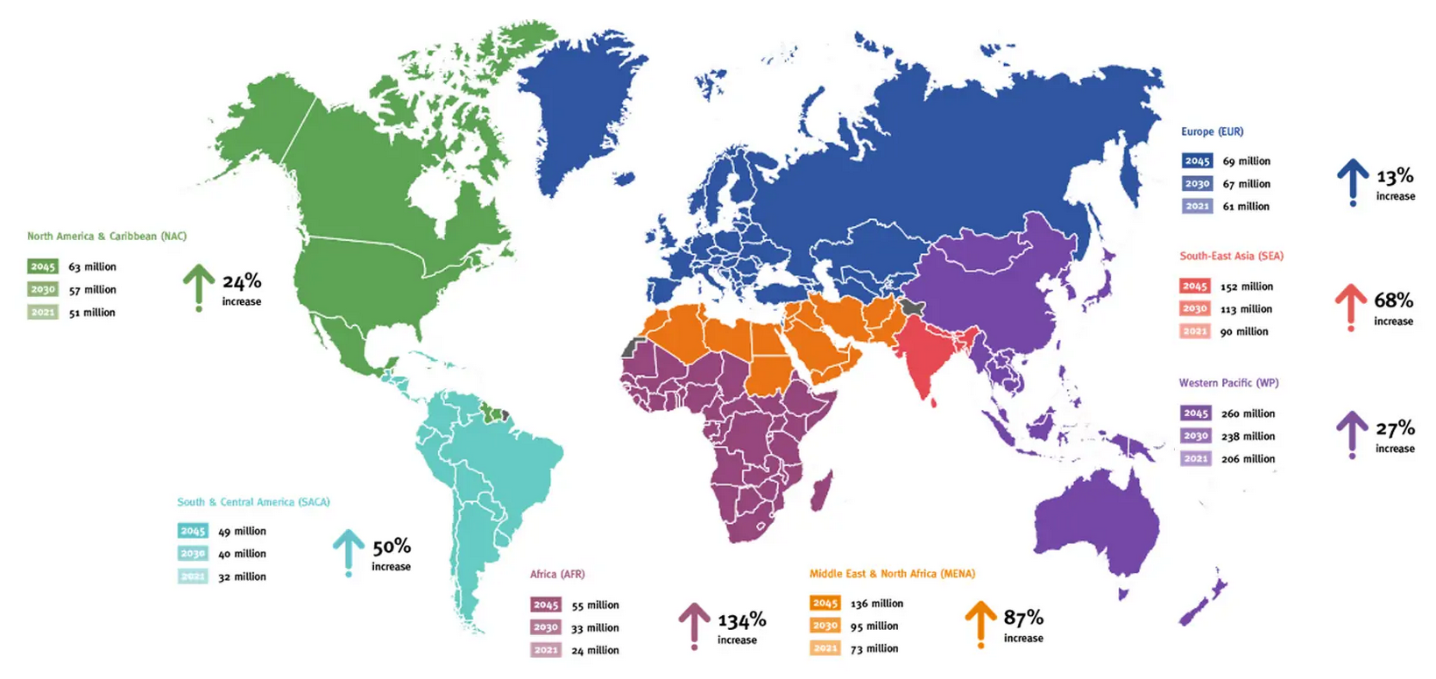
Global View- Diabetes Atlas 2021

Slide 5
BUSINESS PROBLEM
Diabetes facts and figures show the growing global burden for individuals, families, and countries.
Diabetes is a major cause of blindness, kidney failure, heart attacks, stroke, and lower limb amputation. It also imposes a significant economic burden due to healthcare costs and loss of productivity.
This project aims to fill in the gap by analyzing data from CDC Diabetes Health Indicators to identify the relationship between lifestyle and diabetes status and provide actionable insights to improve diabetes care and prevention.

Slide 6
BUSINESS OBJECTIVES
The key objectives are to determine:
Develop a model that can accurately predict diabetes status
Determine the key factors such as that significantly influence Diabetes status.
To provide valuable insights to investors to make informed decisions regarding preventive care for pre and post diabetic patients.
To understand the relationship between lifestyle and Diabetes status

Slide 7
DATA UNDERSTANDING
Variable Name | Demographic | Description
Diabetes_binary |  | 0 = no diabetes 1 = prediabetes or diabetes
HighBP |  | 0 = no high BP 1 = high BP
HighChol |  | 0 = no high cholesterol 1 = high cholesterol
CholCheck |  | 0 = no cholesterol check in 5 years 1 = yes cholesterol check in 5 years
BMI |  | Body Mass Index
Smoker |  | Have you smoked at least 100 cigarettes in your entire life? [Note: 5 packs = 100 cigarettes] 0 = no 1 = yes
Stroke |  | (Ever told) you had a stroke. 0 = no 1 = yes
HeartDiseaseorAttack |  | coronary heart disease (CHD) or myocardial infarction (MI) 0 = no 1 = yes
PhysActivity |  | physical activity in past 30 days - not including job 0 = no 1 = yes
Fruits |  | Consume Fruit 1 or more times per day 0 = no 1 = yes
Veggies |  | Consume Vegetables 1 or more times per day 0 = no 1 = yes
HvyAlcoholConsump |  | Heavy drinkers (adult men having more than 14 drinks per week and adult women having more than 7 drinks per week) 0 = no 1 = yes
AnyHealthcare |  | Have any kind of health care coverage, including health insurance, prepaid plans such as HMO, etc. 0 = no 1 = yes
NoDocbcCost |  | Was there a time in the past 12 months when you needed to see a doctor but could not because of cost? 0 = no 1 = yes
GenHlth |  | Would you say that in general your health is: scale 1-5 1 = excellent 2 = very good 3 = good 4 = fair 5 = poor
MentHlth |  | Now thinking about your mental health, which includes stress, depression, and problems with emotions, for how many days during the past 30 days was your mental health not good? scale 1-30 days
PhysHlth |  | Now thinking about your physical health, which includes physical illness and injury, for how many days during the past 30 days was your physical health not good? scale 1-30 days
DiffWalk |  | Do you have serious difficulty walking or climbing stairs? 0 = no 1 = yes
Sex | Sex | 0 = female 1 = male
Age | Age | 13-level age category (_AGEG5YR see codebook) 1 = 18-24 9 = 60-64 13 = 80 or older
Education | Education Level | Education level (EDUCA see codebook) scale 1-6 1 = Never attended school or only kindergarten 2 = Grades 1 through 8 (Elementary) 3 = Grades 9 through 11 (Some high school) 4 = Grade 12 or GED (High school graduate) 5 = College 1 year to 3 years (Some college or technical school) 6 = College 4 years or more (College graduate)
Income | Income | Income scale (INCOME2 see codebook) scale 1-8 1 = less than $10,000 5 = less than $35,000 8 = $75,000 or more
The Diabetes Health Indicators Dataset contains healthcare statistics and lifestyle survey information about people in general along with their diagnosis of diabetes in the US.

Slide 8
Overview
Data Preparation
Preview of the CDC Diabetes data set.
Review of the data to get a sense of its shape and structure.
Check on the data types of each column and handling any inconsistencies.
Check for missing values in each column.
Handling Outliers
Exploratory Data Analysis
Hypothesis Testing
Future Engineering
Model Building
Evaluation
Deployment

Slide 9
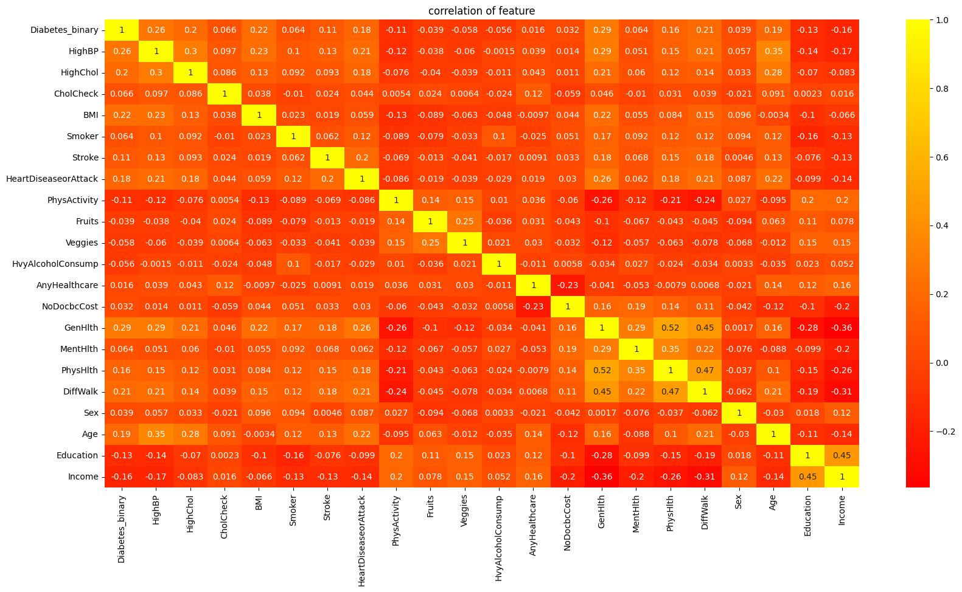
Correlation of features to Diabetes status
Top three features with moderate Positive Correlation: The General health at 25%, Level of high blood pressure at 24% and BMI at 19.7%.
The bottom three features with negative correlation to diabetes status include: The level of Income at 12.5%, Education at 10% and level of physical activity at 7%.

Slide 10
Hypothesis Testing:
H1: There is a statistically significant interaction effect between lifestyle and diabetes status .
Ho: There is no statistically significant relationship between lifestyle and diabetes status

Slide 11
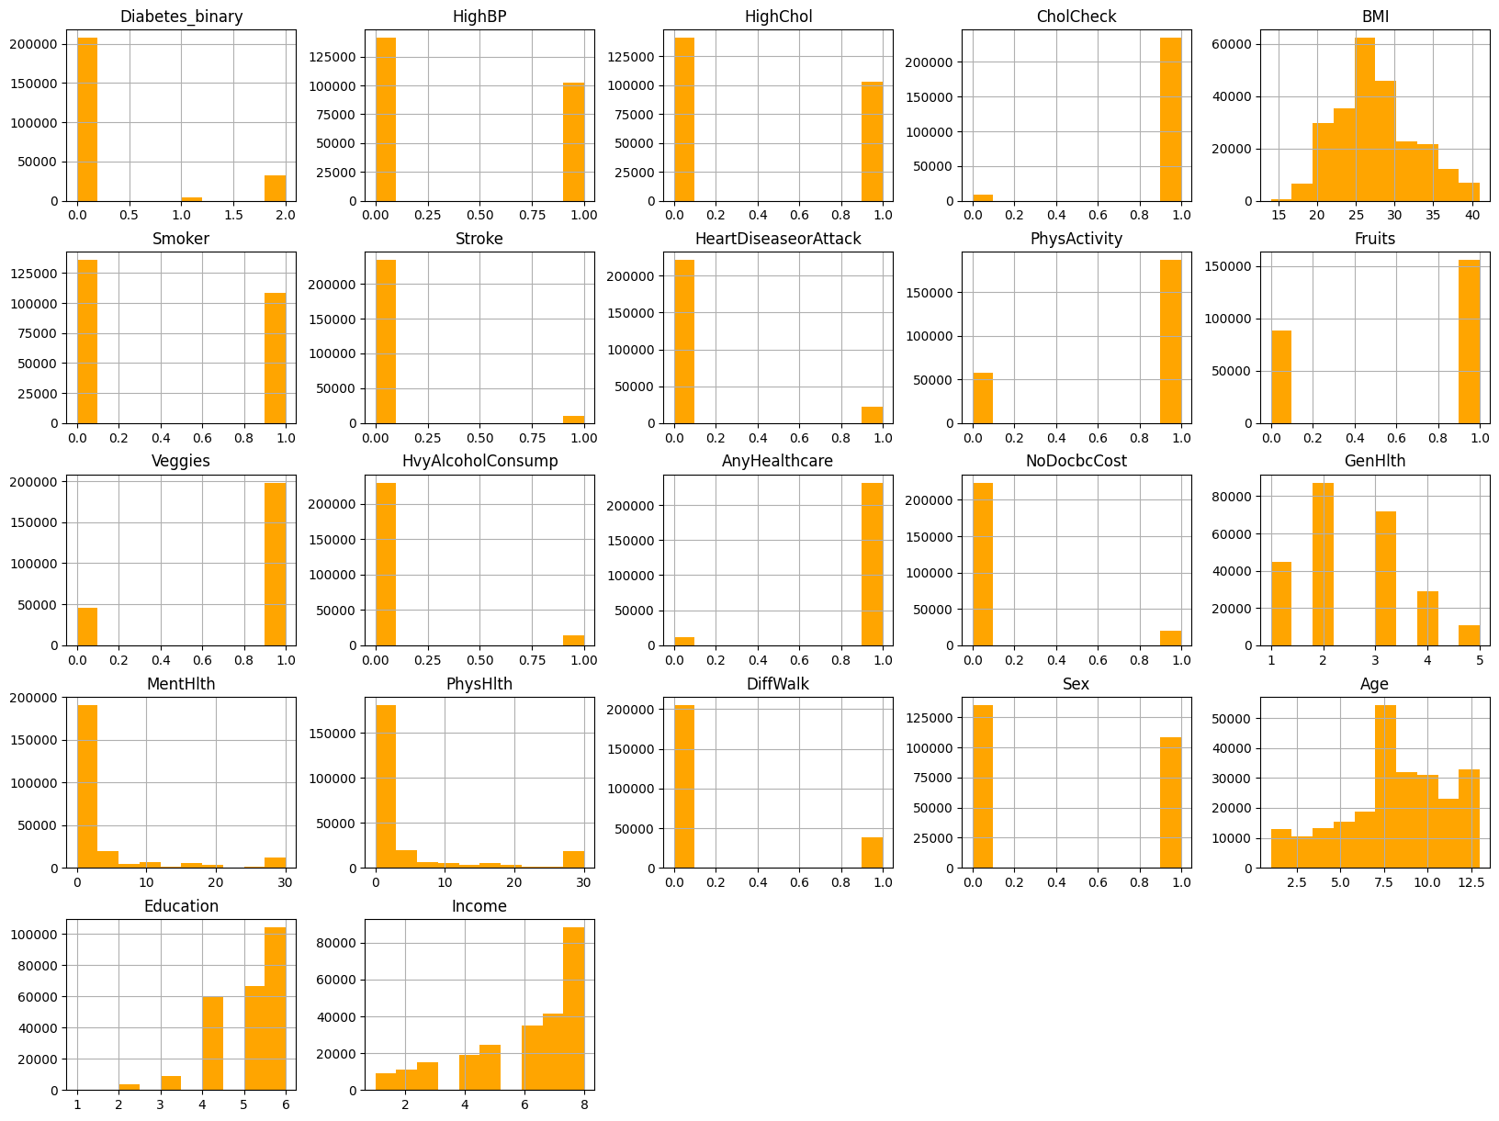
Visualizing Diabetes and independent variables histogram

Slide 12
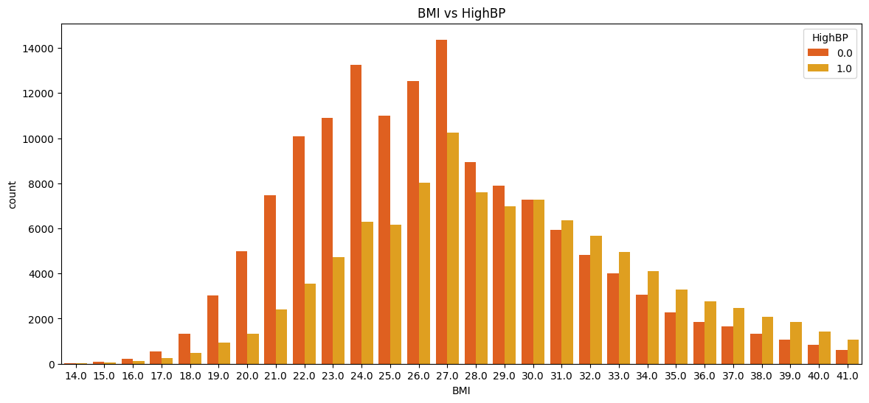
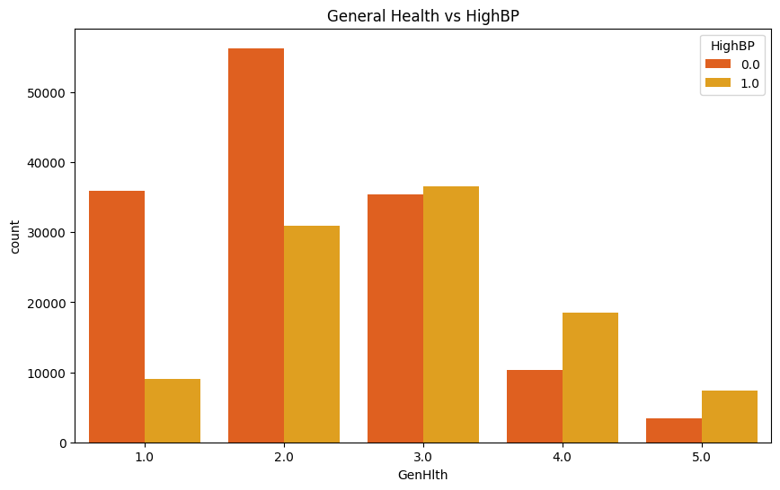
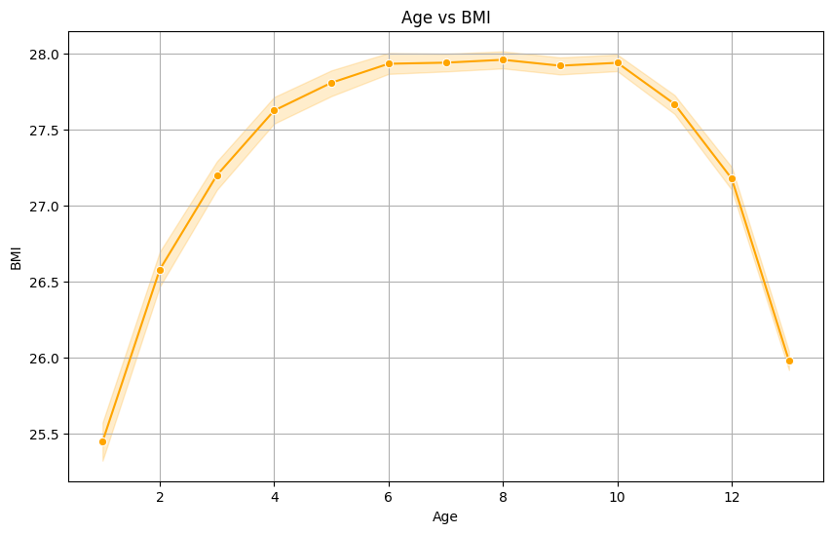
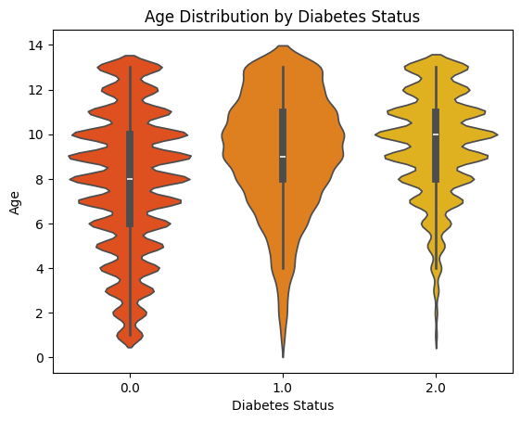
Visualizing Diabetes status and independent variables

Slide 13
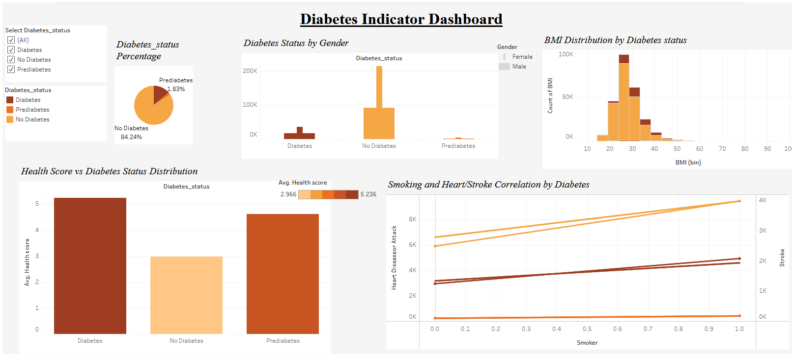
Visualizing Diabetes status and independent variables
84% of the population did not have diabetes, 1.83 were prediabetic and 13% are diabetes.

Slide 14
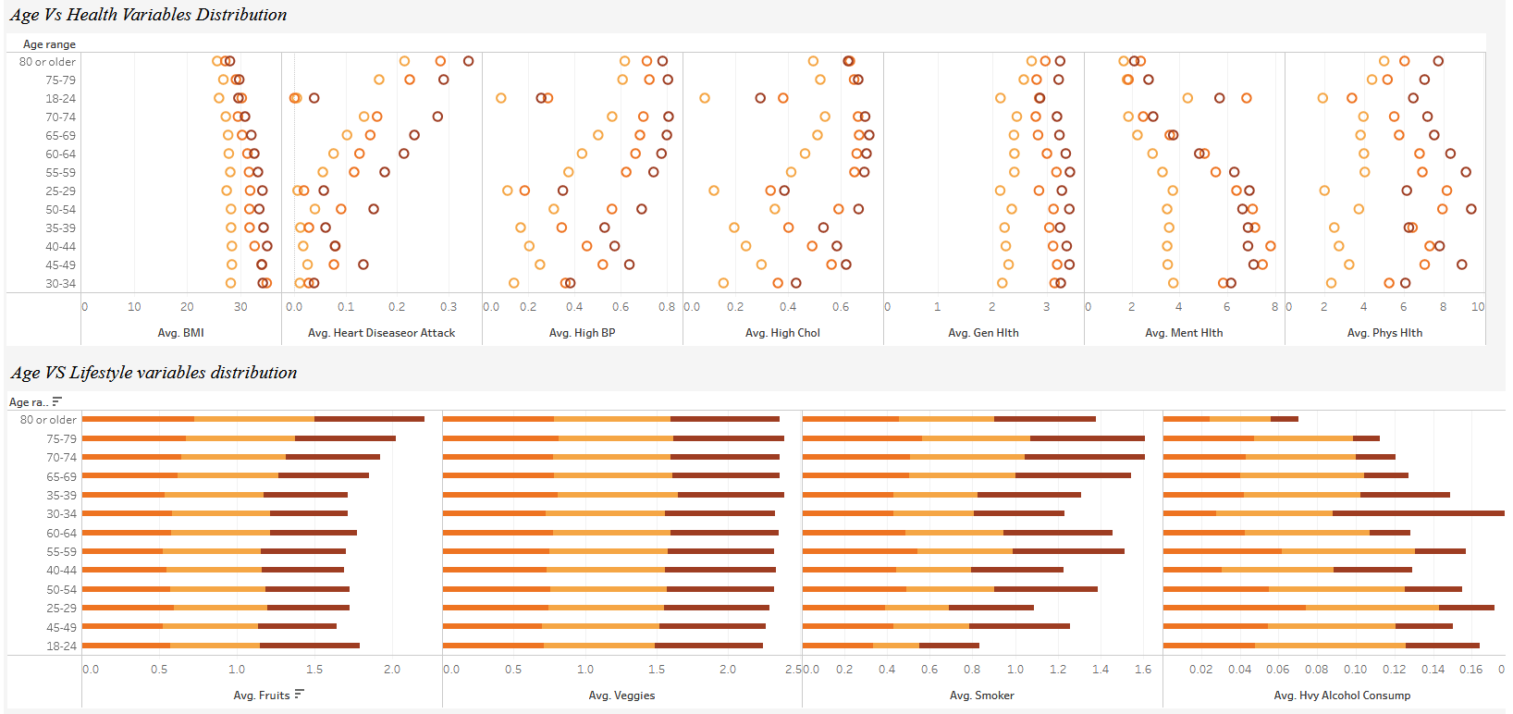
Visualizing Diabetes status and independent variables cont.
Age, Health and lifestyle

Slide 15
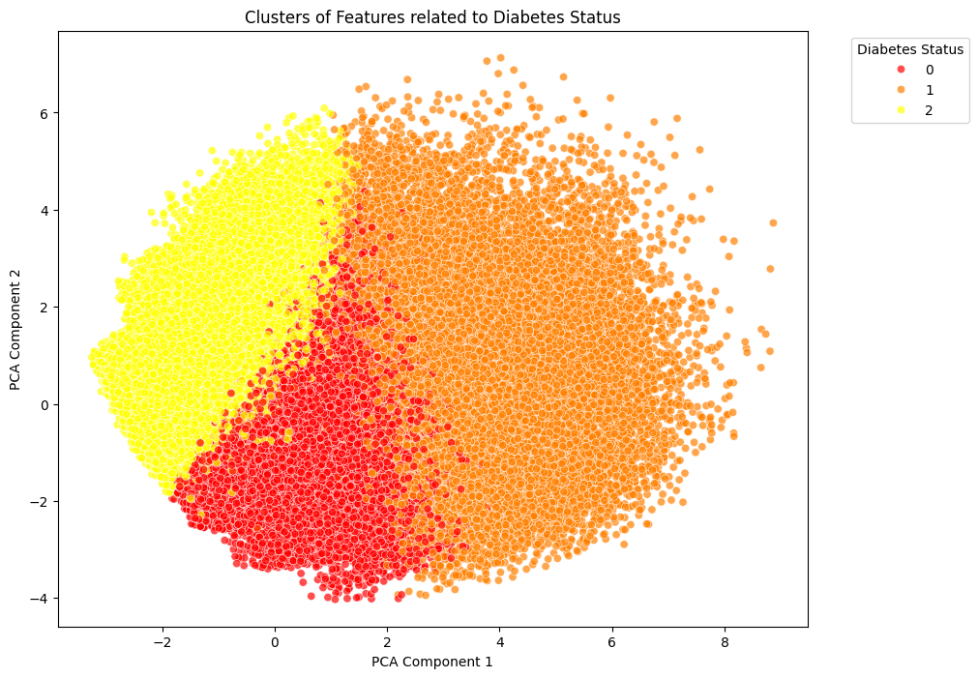
Principal Component Analysis Visualization
21.5% of the variance explain status of the diabetes.

Slide 16
MODELLING

Slide 17
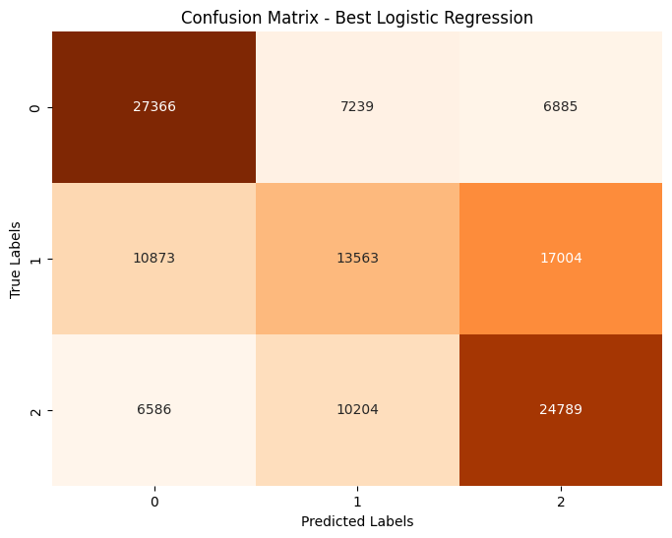
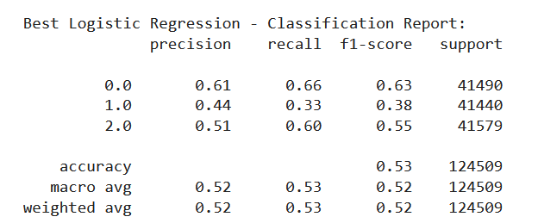
Base Line -Logistic Regression Model

Slide 18
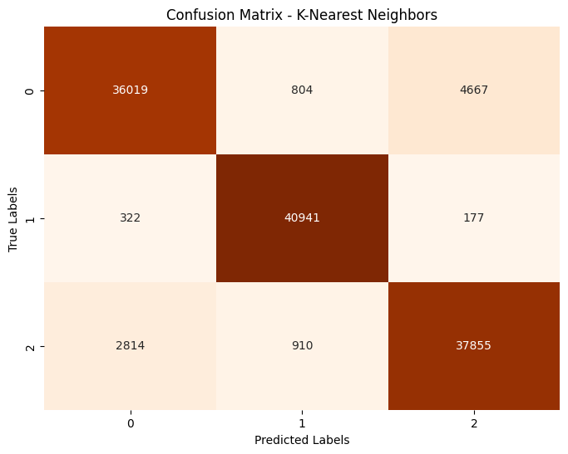
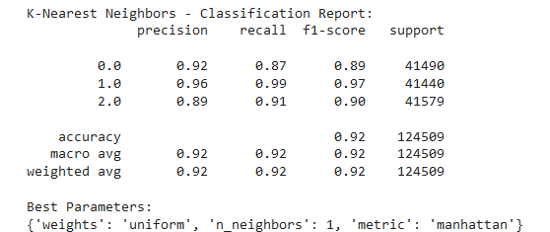
K Nearest Neighbour Model

Slide 19
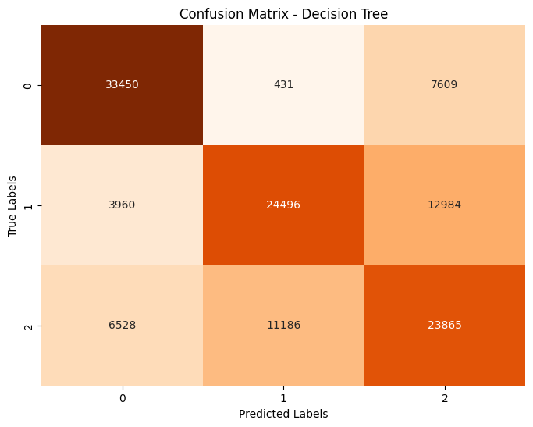
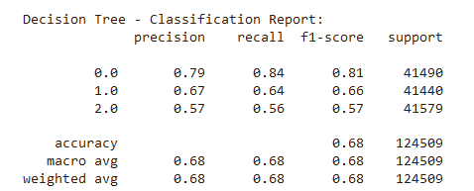
Decision Tree Model

Slide 20
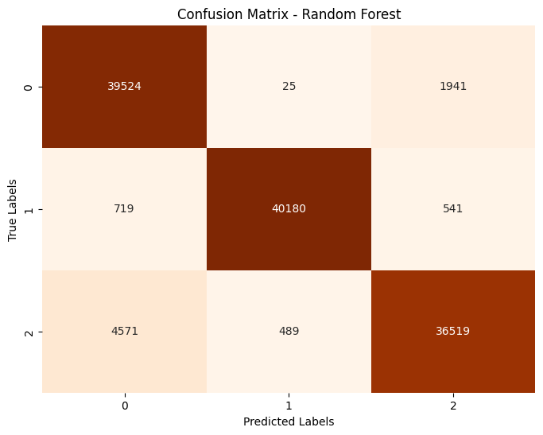
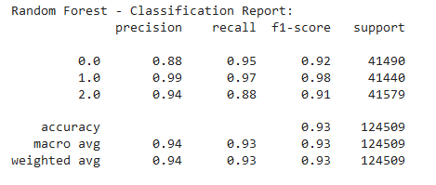
Random Forest

Slide 21
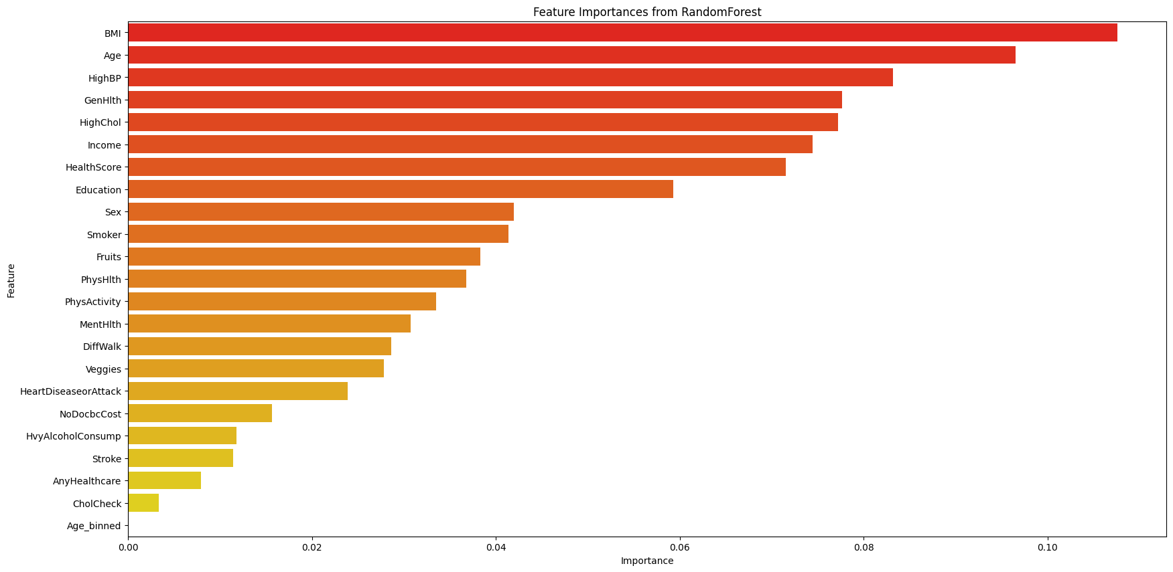
Random Forest- Feature Importance

Slide 22
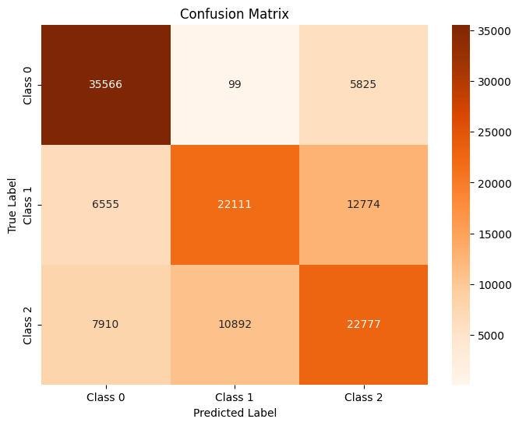
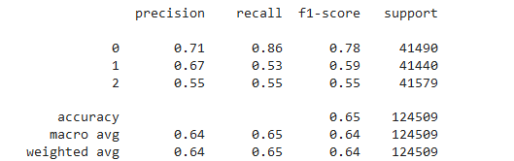
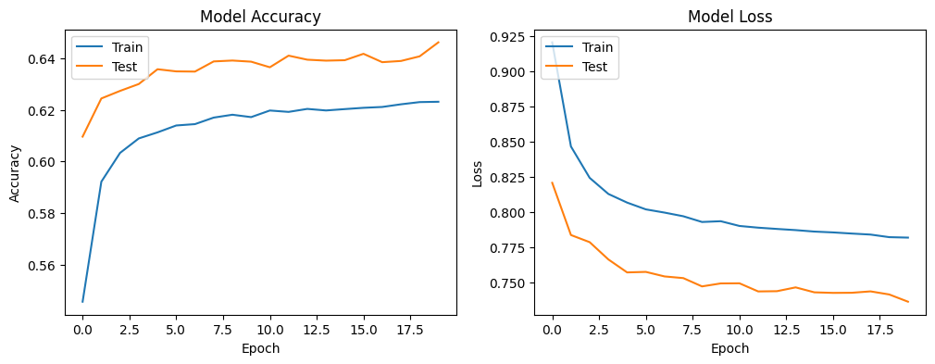
ANN

Slide 23
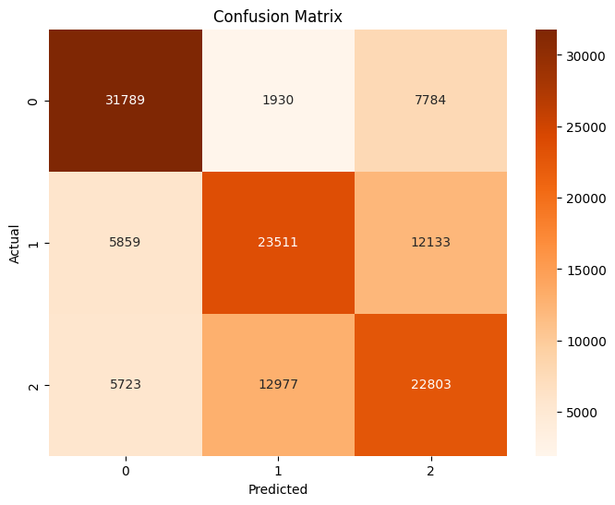
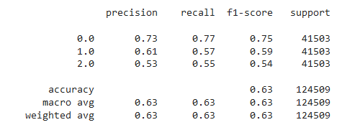
Multilayer Perceptron (MLP) Model

Slide 24
Evaluation

Slide 25
Model Performance
Model | Tuning | Accuracy | Macro Avg F1-Score | Weighted Avg F1-Score
Logistic Regression | Before | 0.53 | 0.52 | 0.52
 | After | 0.53 | 0.52 | 0.52
Decision Tree | Before | 0.62 | 0.60 | 0.60
 | After | 0.88 | 0.88 | 0.88
K-Nearest Neighbors | Before | 0.86 | 0.85 | 0.85
 | After | 0.92 | 0.92 | 0.92
Random Forest | Before | 0.63 | 0.63 | 0.63
 | After | 0.93 | 0.93 | 0.93
Artificial Neural Network | Before | 0.67 | 0.66 | 0.66
 | After | 0.65 | 0.64 | 0.64
Multi-Layer Perceptron | Before | 0.65 | 0.64 | 0.64
 | After | 0.63 | 0.63 | 0.63
Interpretation
Logistic Regression: No change in performance after tuning.
Decision Tree: Significant improvement in accuracy and F1-scores after tuning.
K-Nearest Neighbors: Slight change in performance after tuning.
Random Forest: Significant improvement in accuracy and F1-scores after tuning.
Artificial Neural Network: Slight decrease in performance after tuning.
Multi-Layer Perceptron: Slight decrease in performance after tuning.
The Decision Tree and Random Forest models showed the most significant improvements after tuning, with Random Forest achieving the highest overall accuracy.

Slide 26
Conclusion & Next Steps
Our model results indicate that the Top three key features include BMI, Age and Health Status such as blood pressure.
Preventive measures can be undertaken through maintaining proper diets and providing early diagnosis and proper care for all types of diabetes. These measures can help people living with the condition avoid or delay complications.
Our model can be used to predict the diabetes status to aid in early detection and ensure proper care prevent diabetic complications.

Slide 27
Thank You!

